Slide 1

Department of Artificial Intelligence and Data Science Engineering
AJEENKYA DY PATIL SCHOOL OF ENGINEERING,
Dr. D. Y. Patil Knowledge City, Charholi (Bk.), Via. Lohgaon, Pune – 412 105
FoR ANALYST
Presented by Group-31:
Rohan Aware B-37
Prajakta Sonawane B-55
Shruti Walunj B-73
Rajveer Patil B-27
Under the guidance of:
Prof. Sushma Gunjal

Slide 2
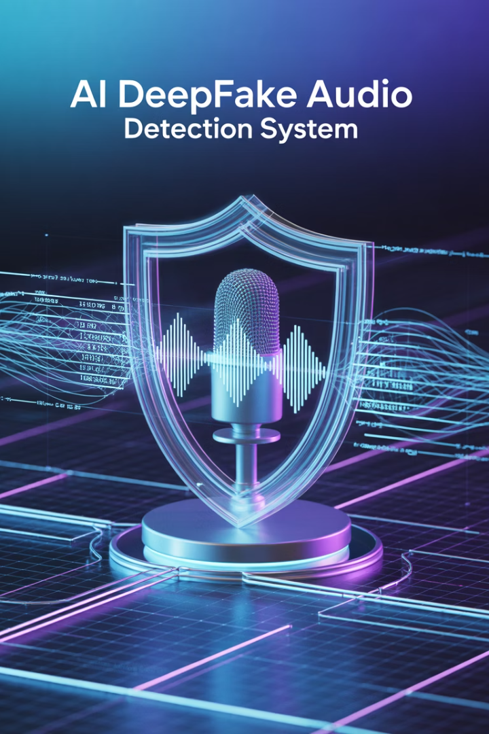
Abstract
Rapid AI Advancement
The rapid advancement in artificial intelligence has given rise to sophisticated deepfake technologies, including deepfake audio, which can convincingly replicate a person's voice.
Significant Risks
This poses significant risks of misinformation, fraud, and unauthorized impersonation.
Project Aim
This project aims to develop a robust system for detecting deepfake audio recordings, ensuring the integrity and authenticity of audio communications.
Multi-faceted Approach
By leveraging a multi-faceted approach to detection, this project seeks to counteract the increasing threats posed by audio deepfakes, providing valuable tools for industries such as media verification, cybersecurity, and digital forensics.

Slide 3

Introduction
Deepfake Audio Technology
Audio Data Manipulation
Deepfake audio, a technology that uses artificial intelligence to generate synthetic voices that closely mimic real human speech, has become increasingly sophisticated and widespread.
By manipulating audio data, deepfake technology can create convincing counterfeit recordings of individuals, often making it difficult to distinguish between authentic and fabricated voices.
Cross-Sector Challenges
This advancement poses significant challenges across various sectors, including security, media, and finance, as it can be used for malicious purposes such as impersonation, spreading misinformation, and committing fraud.

Slide 4



Motivation
Rising Threat
This project is motivated by the rising threat of audio deepfakes, which can be used for fraud and disinformation.
AI-Generated Voices
With AI-generated voices becoming increasingly realistic, manual detection is no longer effective.
Automated Detection
By combining machine learning and acoustic analysis, the goal is to develop an automated system that detects deepfakes, ensuring the authenticity of digital audio and safeguarding industries like cybersecurity and media verification.

Slide 5
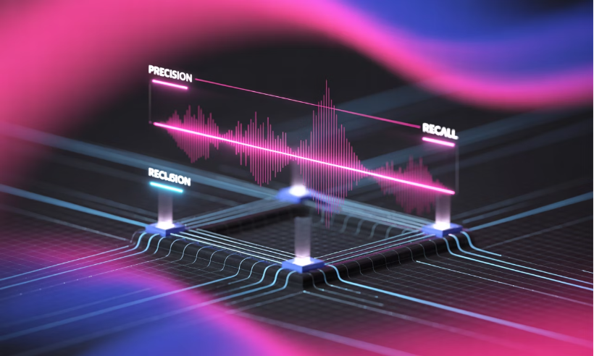
Goals and Objectives
Goals
Objectives
A well-trained deepfake audio detection model capable of identifying manipulated audio recordings with high accuracy.
Develop a robust system to detect deepfake audio recordings with high accuracy and reliability. The system should be able to distinguish between authentic audio recordings and those generated or manipulated using deepfake technologies.
Create effective feature extraction methods
Implement advanced machine learning algorithms
Ensure high detection accuracy
Minimize false positives and negatives

Slide 6
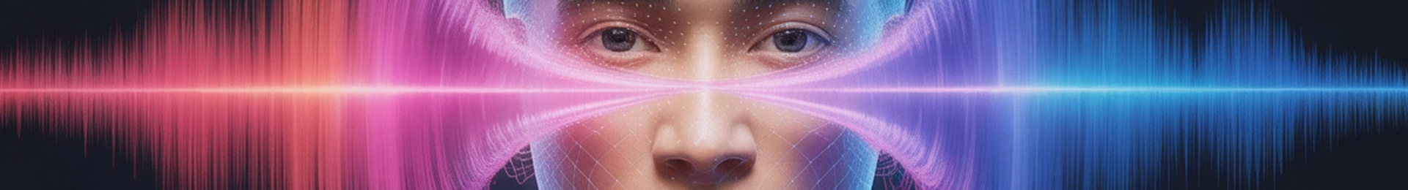



Problem Statement
With the advancement of artificial intelligence and machine learning technologies, deepfake audio has become increasingly sophisticated. Deepfake audio refers to artificially generated or manipulated audio recordings that convincingly mimic a person's voice. This technology can be used maliciously to deceive, impersonate, or spread misinformation. Detecting such audio manipulations is crucial for maintaining the integrity of communication and protecting against fraudulent activities.
Deception
Malicious actors can create convincing voice impersonations
Impersonation
Unauthorized voice cloning for fraudulent purposes
Misinformation
Spreading false information through fake audio recordings

Slide 7
Literature Survey
Sr. No
Title of Paper & Author
Name of Publisher and Year
Description
Challenges
1.
Mixture of Experts Fusion for Fake Audio Detection Using Frozen wav2vec 2.0; Zhiyong Wang, Ruibo Fu, Zhengqi Wen, Jianhua Tao, Xiaopeng Wang1, Yuankun Xie, Xin Qi, Shuchen Shi, Yi Lu, Yukun Liu, Chenxing Li, Xuefei Liu, Guanjun Li
2024/9/18; arXiv preprint arXiv:2409.11909
Most of the previously proposed fusion methods require fine-tuning the pretrained models, resulting in excessively long training times and hindering model iteration when facing new speech synthesis technology. To address this issue, this paper proposes a feature fusion method based on the Mixture of Experts, which extracts and integrates features relevant to fake audio detection from layer features, guided by a gating network based on the last layer feature, while freezing the pretrained model.
When setting the number of experts per layer feature to 6 or 8, there are improvements in both EER results on the 19LA evaluation set, but the EER results on the other three evaluation sets decline compared to the baseline model. This demonstrates that increasing the number of experts does not necessarily improve the model's generalization performance; in fact, it may lead to overfitting.
2.
Open Challenges in Synthetic Speech Detection; Luca Cuccovillo, Christoforos Papastergiopoulos, Anastasios Vafeiadis, Artem Yaroshchuk, Patrick Aichroth, Konstantinos Votis, and Dimitrios Tzovaras
arXiv:2209.07180v3 [eess.AS] 26 Jan 2023
In this paper the current status and open challenges of synthetic speech detection are addressed. The work comprises an initial analysis of available open datasets and of existing detection methods, a description of the requirements for new research datasets compliant with regulations and better representing real-case scenarios, and a discussion of the desired characteristics of future trustworthy detection methods in terms of both functional and non-functional requirements.
The first challenge related to the collection of data suitable for research on synthetic speech detection, is the collection of real data. A second challenge related to the collection of data suitable for research on synthetic speech detection, is the creation of representative synthetic data. As spoofing attacks can be unpredictable in nature, it is important to develop robust models able to identify the relevant artifacts in speech recordings and generalize well to unknown scenarios. Federated Learning: In recent years, data regulations and privacy concerns for data sharing among different parties of a network, increased the demand for distributed learning methodologies.

Slide 8
Literature Survey
Sr. No
Title of Paper & Author
Name of Publisher and Year
Description
Challenges
3.
A Noval Feature via Color Quantisation for Fake Audio Detection; Zhiyong Wang, Xiaopeng Wang, Yuankun Xie, Ruibo Fu1, Zhengqi Wen5, Jianhua Tao, Yukun Liu, Guanjun Li, Xin Qi, Yi Lu, Xuefei Liu, Yongwei Li
arXiv:2408.10849v1 [cs.SD] 20 Aug 2024
This paper proposes a noval feature extraction method via color quantisation which constrains the reconstruction to use a limited number of colors for the spectral image-like input. The proposed method ensures reconstructed input differs from the original, which allows for intuitive observation of the focus areas in the spectral reconstruction.
Interpretability: Traditional methods for fake audio detection often struggle with interpretability, making it difficult to intuitively distinguish between real and fake audio1. Color Quantization Constraints: The proposed method constrains the reconstruction to use a limited number of colors, which can be challenging as it requires the model to effectively highlight the differences in the spectral features2.
4.
Temporal Variability and Multi-Viewed Self-Supervised Representations to Tackle the ASVspoof5 Deepfake Challenge; Yuankun Xie, Xiaopeng Wang, Zhiyong Wang, Ruibo Fu, Zhengqi Wen, Haonan Cheng, Long Ye
arXiv:2408.06922v1 [cs.SD] 13 Aug 2024
In this paper, we focus on addressing the problem of open-domain audio deepfake detection, which corresponds directly to the ASVspoof5 Track1 open condition. At first, we comprehensively investigate various CM on ASVspoof5, including data expansion, data augmentation, and self-supervised learning (SSL) features. Due to the high-frequency gaps characteristic of the ASVspoof5 dataset, we introduce Frequency Mask, a data augmentation method that masks specific frequency bands to improve CM robustness.
Multi-Viewed Representations: Combining multiple perspectives or views of the audio data helps in capturing different aspects of the signal. However, integrating these views effectively to improve detection accuracy is challenging. Self-Supervised Learning (SSL): Leveraging SSL features can enhance the model's ability to learn from unlabeled data. The challenge lies in effectively utilizing these features to improve the robustness of the countermeasures

Slide 9
Literature Survey
Sr. No
Title of Paper & Author
Name of Publisher and Year
Description
Challenges
5.
Genuine-Focused Learning using Mask AutoEncoder for Generalized Fake Audio Detection; Xiaopeng Wang, Ruibo Fu, Zhengqi Wen, Zhiyong Wang, Yuankun Xie, Yukun Liu, Jianhua Tao, Xuefei Liu, Yongwei Li, Xin Qi, Yi Lu, Shuchen Shi
arXiv:2406.03247v2 [cs.SD] 9 Jun 2024
This paper propose a Genuine-Focused Learning (GFL) framework guided, aiming for highly generalized FAD, called GFL-FAD. This method incorporates a Counterfactual Reasoning Enhanced Representation (CRER) based on audio reconstruction using the Mask AutoEncoder (MAE) architecture to accurately model genuine audio features.
Genuine Audio Reconstruction: The method focuses on accurately modeling genuine audio features using a Mask AutoEncoder (MAE). Ensuring that the reconstruction loss effectively captures genuine audio characteristics without being influenced by spoofed audio is challenging. Counterfactual Reasoning Enhanced Representation (CRER): Integrating CRER with the MAE architecture to enhance the model's ability to distinguish between genuine and fake audio requires sophisticated design and tuning.
6.
Generalized Fake Audio Detection via Deep Stable Learning Zhiyong Wang, Ruibo Fu, Zhengqi Wen, Yuankun Xie, Yukun Liu, Xiaopeng Wang, XuefeiLiu, Yongwei Li, Jianhua Tao, Yi Lu, Xin Qi, Shuchen Shi
arXiv:2406.03237v1 [cs.SD] 5 Jun 2024
In this work, we propose a stable learning-based training scheme that involves a Sample Weight Learning (SWL) module, addressing distribution shift by decorrelating all selected features via learning weights from training samples. The proposed portable plug-inlike SWL is easy to apply to multiple base models and generalizes them without using extra data during training.
Distribution Shift: One of the primary challenges is dealing with distribution shifts between training and evaluation datasets. Current fake audio detection methods often perform well on specific datasets but fail when tested on datasets with different distributions. Sample Weight Learning (SWL): The proposed method involves a Sample Weight Learning module to address distribution shifts by decorrelating selected features. Implementing this effectively across various base models without using extra data during training is challenging

Slide 10
Literature Survey
Sr. No
Title of Paper & Author
Name of Publisher and Year
Description
Challenges
7.
The Codecfake Dataset and Countermeasures for the Universally Detection of Deepfake Audio Yuankun Xie, Yi Lu, Ruibo Fu, Zhengqi Wen, Zhiyong Wang, Jianhua Tao, Xin Qi, Xiaopeng Wang, Yukun Liu, Haonan Cheng, Long Ye
arXiv:2405.04880v2 [cs.SD] 15 May 2024
This paper initially construct the Codecfake dataset, an open-source large-scale dataset, including 2 languages, over 1M audio samples, and various test conditions, focus on ALM-based audio detection. As countermeasure, to achieve universal detection of deepfake audio and tackle domain ascent bias issue of original SAM, we propose the CSAM strategy to learn a domain balanced and generalized minima.
High Deception and Versatility: ALM-based deepfake audio exhibits high deception and versatility, making it difficult for current detection models, which are often trained on vocoded data, to accurately identify fake audio. Distribution Shift: Addressing distribution shifts between training and evaluation datasets is crucial. The Codecfake dataset aims to provide a more comprehensive training set to improve generalization across different types of deepfake audio
8.
An Efficient Temporary Deepfake Location Approach Based Embeddings For Partially Spoofed Audio Detection Yuankun Xie, Haonan Cheng, Yutian Wang, Long Ye
arXiv:2309.03036v2 [cs.SD] 21 Nov 2023
In this work, we propose a fine-grained partially spoofed audio detection method, namely Temporal Deepfake Location (TDL), which can effectively capture information of both features and locations. Specifically, our approach involves two novel parts: embedding similarity module and temporal convolution operation. To enhance the identification between the real and fake features, the embedding similarity module is designed to generate an embedding space that can separate the real frames from fake frames.
Localization of Spoofed Segments: Identifying the exact segments of audio that have been spoofed is challenging, especially when only parts of the audio are manipulated. This requires precise and efficient algorithms to detect these segments accurately. Embedding Effectiveness: Using embeddings to represent audio features can be powerful, but ensuring that these embeddings effectively capture the nuances of both genuine and spoofed audio is complex. The embeddings must be robust enough to differentiate between subtle manipulations.

Slide 11
Literature Survey
Sr. No
Title of Paper & Author
Name of Publisher and Year
Description
Challenges
9.
Towards End-to-End Synthetic Speech Detection Guang Hua, Andrew Beng Jin Teoh, Haijian Zhang,
arXiv:2106.06341v1 [eess.AS] 11 Jun 2021
The proposed model is termed Time-domain Synthetic Speech Detection Net (TSSDNet), having ResNet- or Inception-style structures. We further demonstrate that the proposed models also have attractive generalization capability. Trained on ASVspoof2019, they could achieve promising detection performance when tested on disjoint ASVspoof2015, significantly better than the existing cross-dataset results.
Feature Extraction: Traditional methods rely on hand-crafted features, which can be limiting. Transitioning to end-to-end deep neural networks (DNNs) that automatically learn features from raw audio data is challenging but necessary for improved performance. Model Complexity: Designing lightweight yet effective neural network architectures, such as ResNet or Inception-style structures, is crucial. Balancing model complexity with computational efficiency is a significant challenge.
10.
Audio Deepfake Detection With Self-supervised Wavlm And Multi-fusion Attentive Classifier Yinlin Guo, Haofan Huang, Xi Chen, He Zhao, Yuehai Wang
arXiv:2312.08089v2 [eess.AS] 10 Jan 2024
In this paper, we report our efforts to combine the self-supervised WavLM model and Multi-Fusion Attentive classifier for audio deepfake detection. Our method exploits the WavLM model to extract features that are more conducive to spoofing detection for the first time. Then, we propose a novel Multi-Fusion Attentive (MFA) classifier based on the Attentive Statistics Pooling (ASP) layer. The MFA captures the complementary information of audio features at both time and layer levels.
Multi-Fusion Attentive Classifier: Integrating multiple sources of information through a Multi-Fusion Attentive (MFA) classifier involves capturing complementary information from different audio features at both time and layer levels. This requires sophisticated design and tuning. Temporal Dynamics: Handling the temporal aspects of audio signals is essential. The model needs to account for changes over time and detect inconsistencies that may indicate spoofing.

Slide 12




Requirements
HARDWARE REQUIREMENTS
SOFTWARE REQUIREMENTS
System: Pentium i3 Processor.
Operating system: Windows 10 Pro.
Hard Disk: 500 GB.
Coding Language: Python 3.10.9, Tensorflow
Monitor: 15" LED
Web Framework: Flask, HTML, CSS, JS
Input Devices: Keyboard, Mouse
Ram: 4 GB
Processing Power
Storage Capacity
Development Environment
Web Interface
Sufficient CPU capabilities for audio analysis algorithms
Adequate space for audio datasets and model storage
Framework for creating user-friendly detection portal
Python ecosystem with machine learning libraries

Slide 13
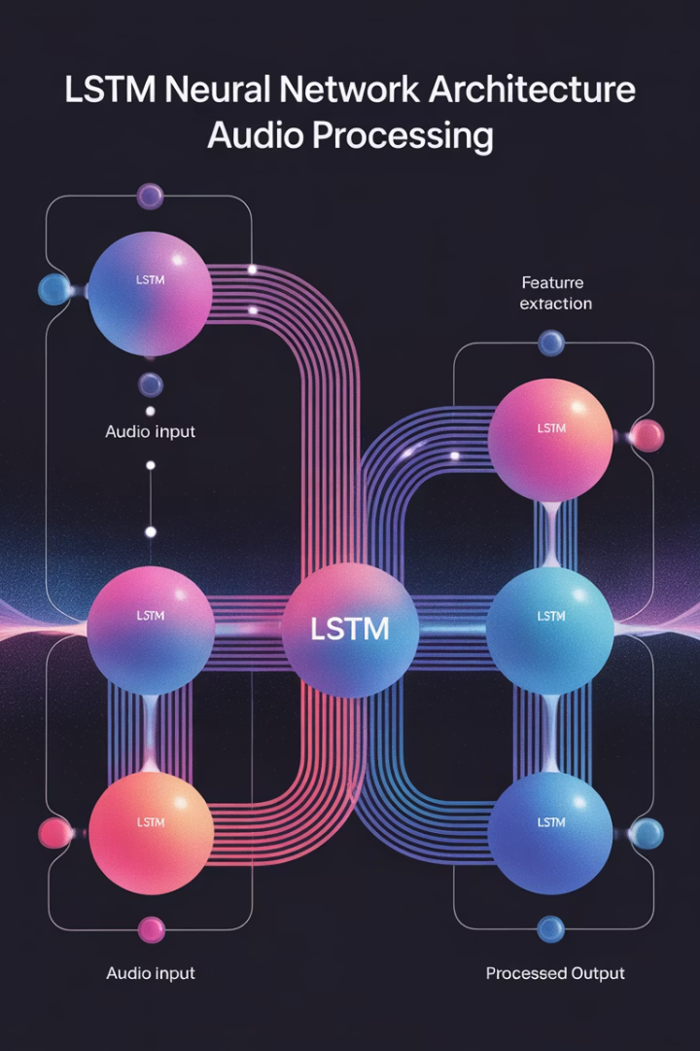
Proposed System and Proposed Outcome
RNN-Based Detection System
In this project, we propose a deepfake audio detection system leveraging the capabilities of Recurrent Neural Networks (RNNs), specifically Long Short-Term Memory (LSTM) networks.
Temporal Dependencies Analysis
The proposed system aims to exploit the sequential nature of audio signals, capturing temporal dependencies and subtle inconsistencies that are characteristic of deepfake manipulations.
Feature Extraction
Our approach begins with preprocessing the audio data to extract relevant features such as Mel-frequency cepstral coefficients (MFCCs), which serve as inputs to the LSTM network.
Pattern Recognition
The LSTM model is designed to process these features over time, learning to identify patterns and anomalies that distinguish genuine audio from synthetic counterparts.

Slide 14
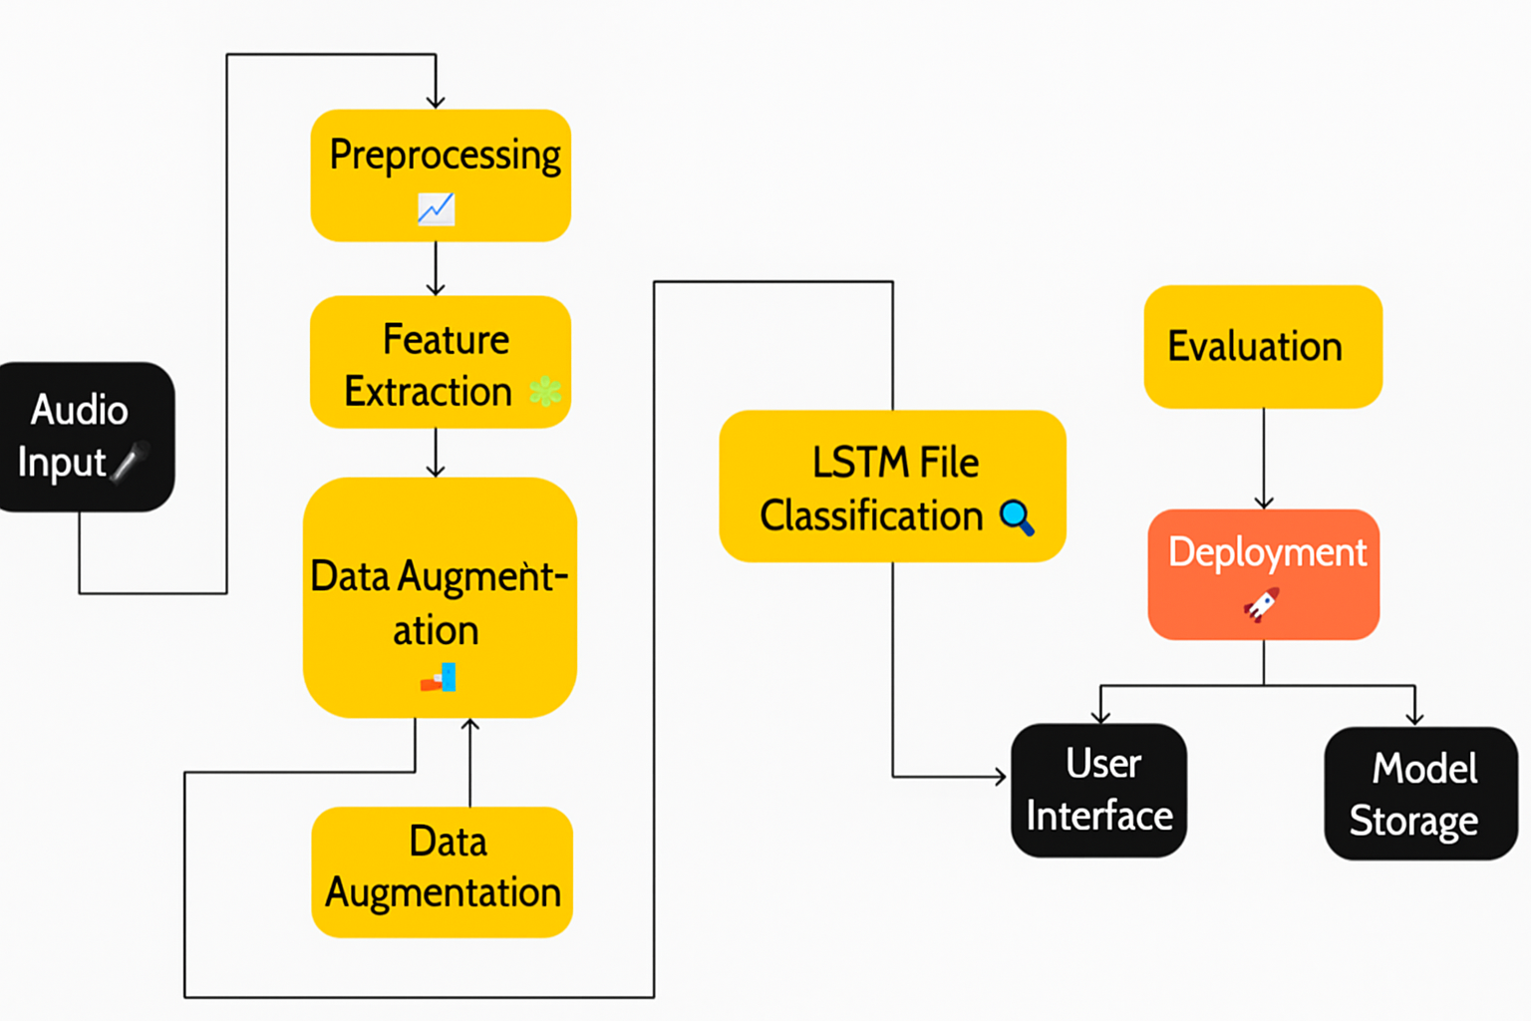
Architecture

Slide 15
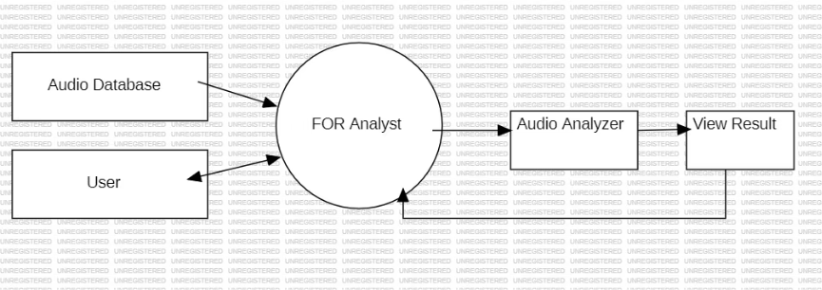
DFD Level 0

Slide 16
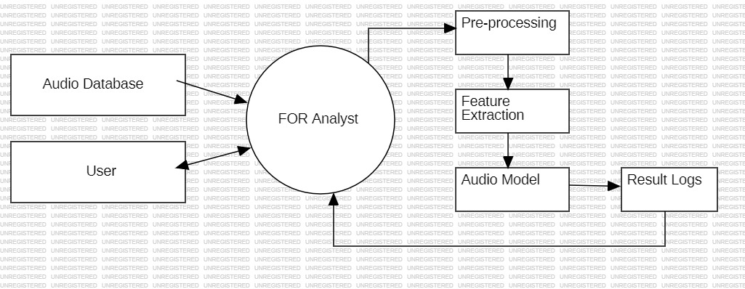
DFD Level 1

Slide 17
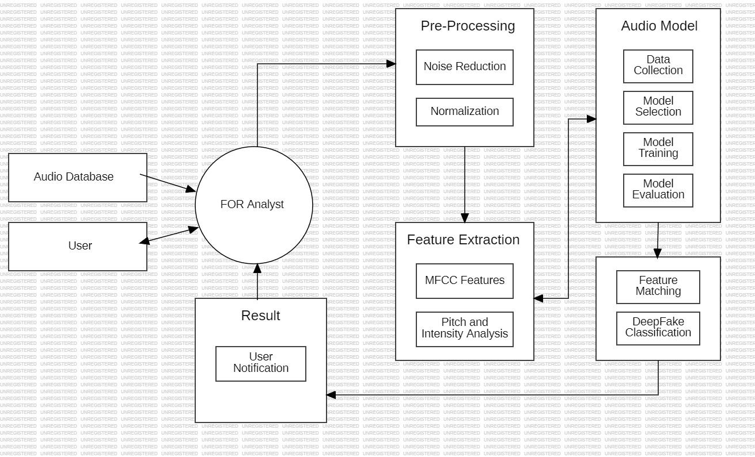
DFD Level 2

Slide 18
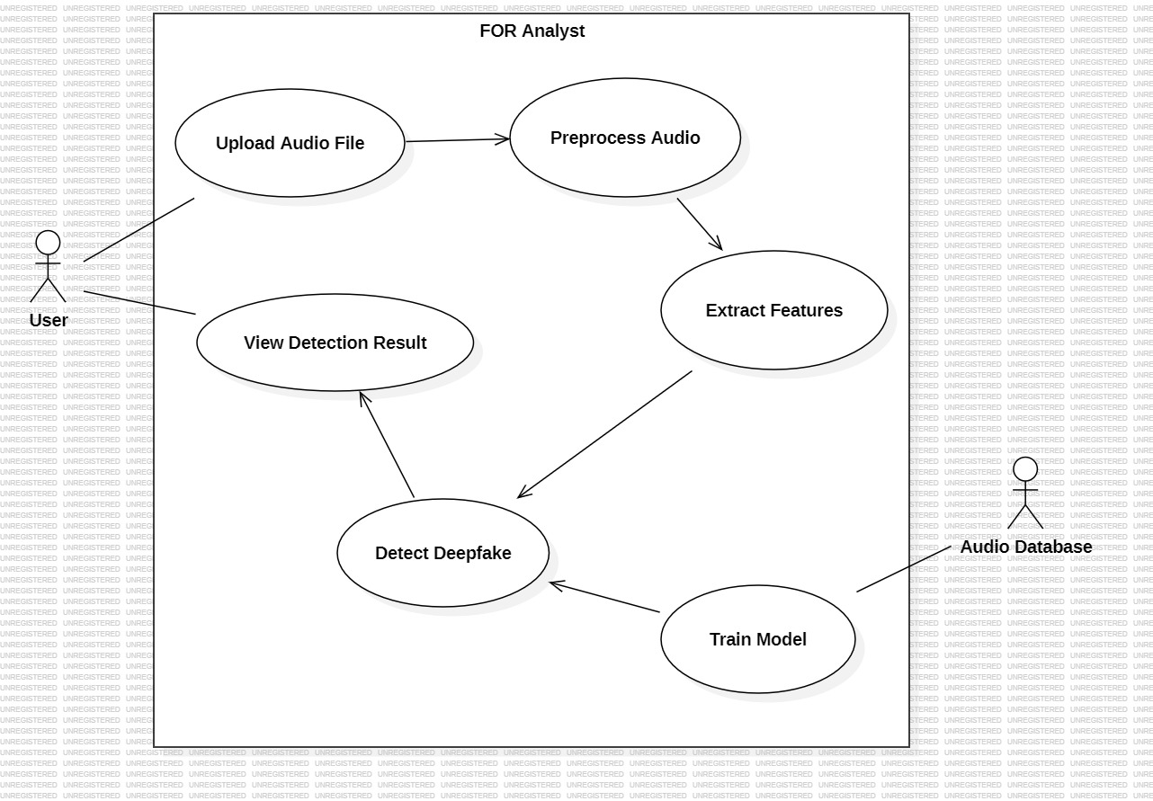
Use Case Diagram
Primary Actors
Key Use Cases
End User
Upload Audio File
Model Trainer
Analyze Audio
View Detection Results
Train Detection Model
Manage System
System Boundaries
Web Interface
Detection Engine
Training Module
The Use Case Diagram illustrates the interactions between different users and the deepfake audio detection system. It shows the main functionalities available to each type of user and how they interact with the system components.

Slide 19
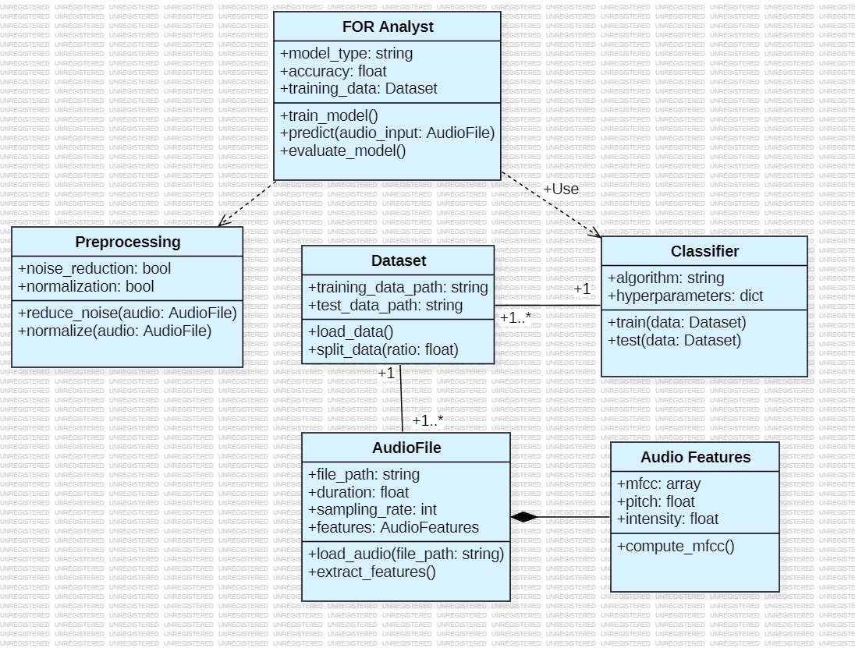
Class Diagram
The Class Diagram shows the object-oriented structure of the deepfake audio detection system, illustrating the main classes, their attributes, methods, and the relationships between them. This diagram helps understand the system's internal organization and how different components interact to perform the detection process.

Slide 20
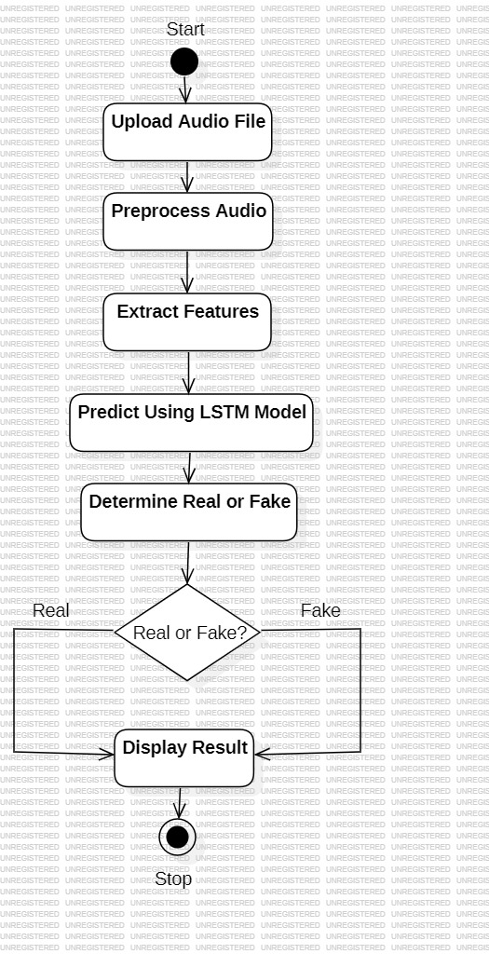






Activity Diagram
The Activity Diagram illustrates the sequential flow of activities in the deepfake audio detection process, from the initial upload of an audio file to the final presentation of detection results. It shows the decision points and parallel activities that occur during the detection workflow.
Start Process
User initiates detection by uploading audio
Validate Input
System checks file format and quality
Extract Features
System processes audio to extract MFCC features
Apply LSTM Model
Features are analyzed by the neural network
Generate Score
System calculates authenticity probability
Present Results
User receives detection outcome and report

Slide 21
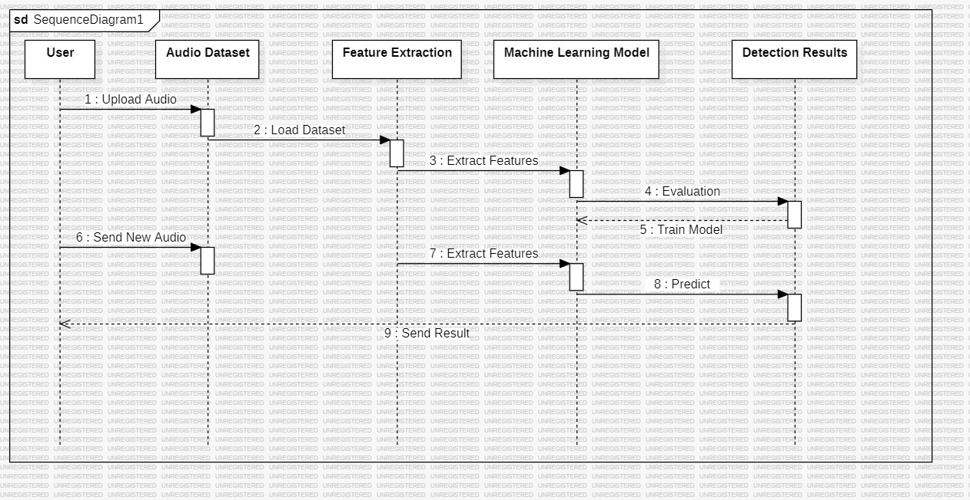
Sequence Diagram
The Sequence Diagram shows the time-ordered interactions between different components of the deepfake audio detection system during a typical detection process. It illustrates how messages are passed between the user interface, server, processing modules, and database to complete the detection workflow.

Slide 22
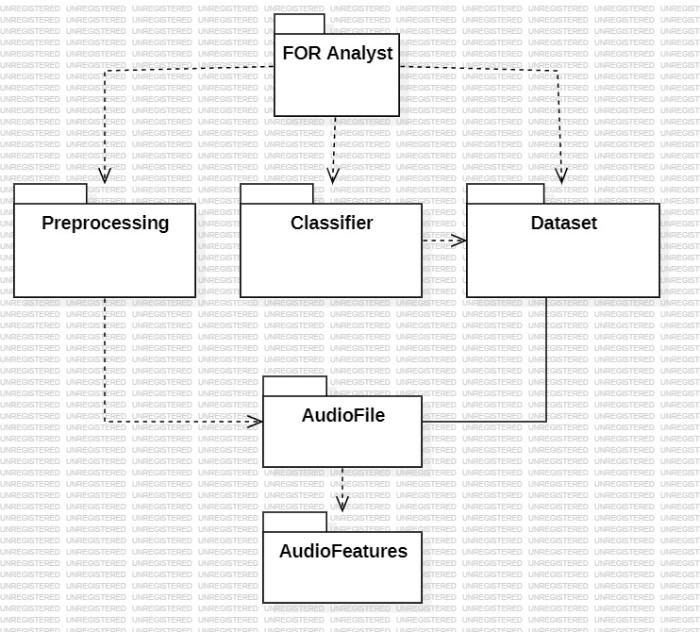
Package Diagram
The Package Diagram shows the organization of the deepfake audio detection system into logical groups of related components. It illustrates the dependencies between different packages and helps understand the system's modular structure.

Slide 23
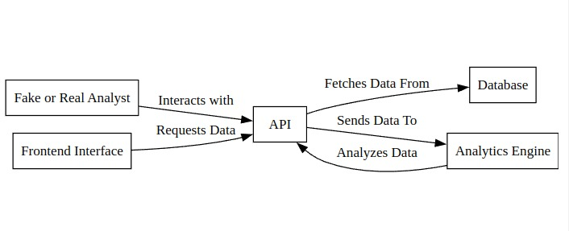
Deployment Diagram
The Deployment Diagram illustrates the physical architecture of the deepfake audio detection system, showing how different hardware components are connected and how software components are distributed across the physical infrastructure.

Slide 24
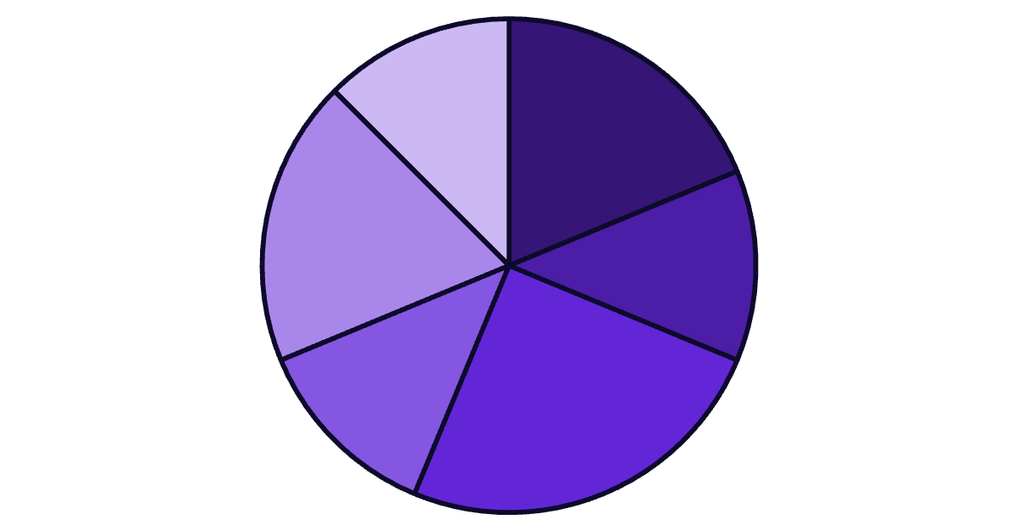
Implementation
Data Collection
Feature Extraction
Model Development
Testing
UI Development
Integration
The implementation phase involved several key components, with model development taking the largest portion of development time at 4 weeks. Data collection and UI development each required 3 weeks, while feature extraction, testing, and integration each took 2 weeks to complete. This distribution reflects the complexity of developing an accurate LSTM-based deepfake detection system.

Slide 25
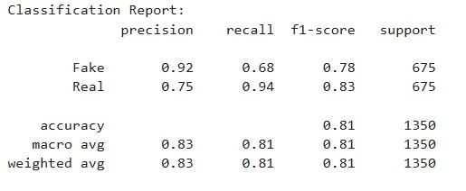
Performance Metrics: Classification Report
The classification report shows detailed performance metrics for the deepfake audio detection model. With high precision, recall, and F1-scores across both classes (real and fake), the model demonstrates strong performance in correctly identifying both authentic and deepfake audio recordings. The balanced accuracy across classes indicates that the model is not biased toward either class.

Slide 26
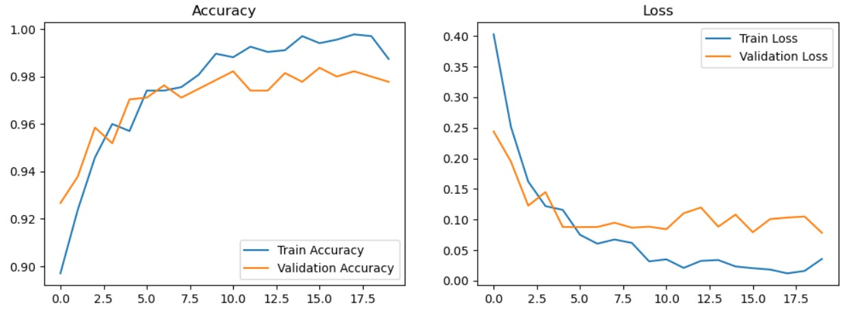
Performance Metrics: Accuracy & Loss
Training Progress
Key Observations
The graphs show the model's accuracy and loss metrics during training. The steady improvement in accuracy and decrease in loss over epochs indicate effective learning. The close alignment between training and validation curves suggests the model is generalizing well without overfitting.
Training accuracy reached 81% by epoch 20
Validation accuracy closely follows training accuracy
Loss function shows consistent decrease
No significant signs of overfitting
Model converged successfully
These performance metrics demonstrate that the LSTM-based deepfake audio detection model is learning effectively from the training data and generalizing well to unseen examples. The consistent improvement in accuracy and reduction in loss across training epochs indicate successful model optimization.

Slide 27
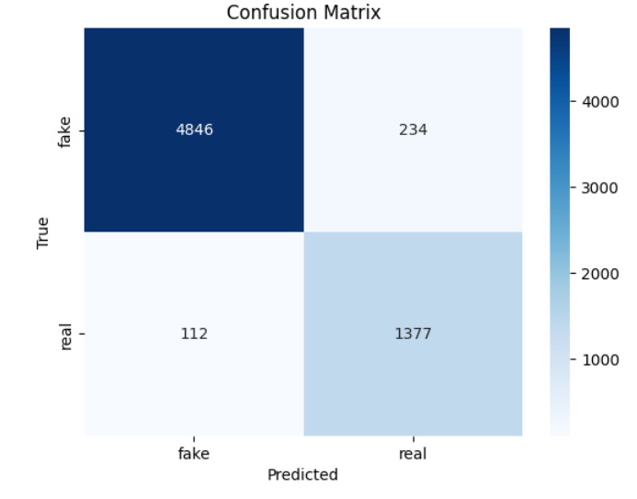
Performance Metrics: Confusion Matrix
True Positives
The model correctly identified 1377 deepfake audio samples as fake.
True Negatives
The model correctly identified 4846 authentic audio samples as real.
False Positives
The model incorrectly classified 112 authentic audio samples as fake.
False Negatives
The model incorrectly classified 234 deepfake audio samples as real.
The confusion matrix provides a detailed breakdown of the model's predictions, showing the number of correct and incorrect classifications for each class. With high numbers of true positives and true negatives, and low numbers of false positives and false negatives, the matrix confirms the model's strong performance in distinguishing between real and deepfake audio recordings.

Slide 28
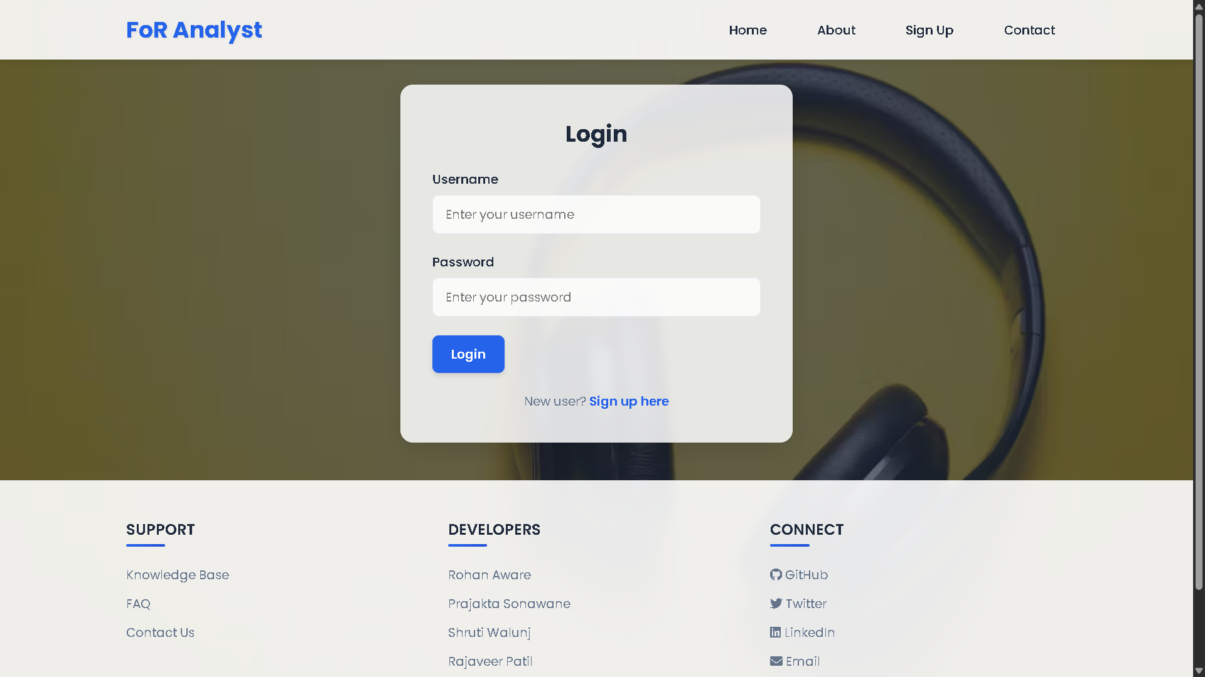

Slide 29
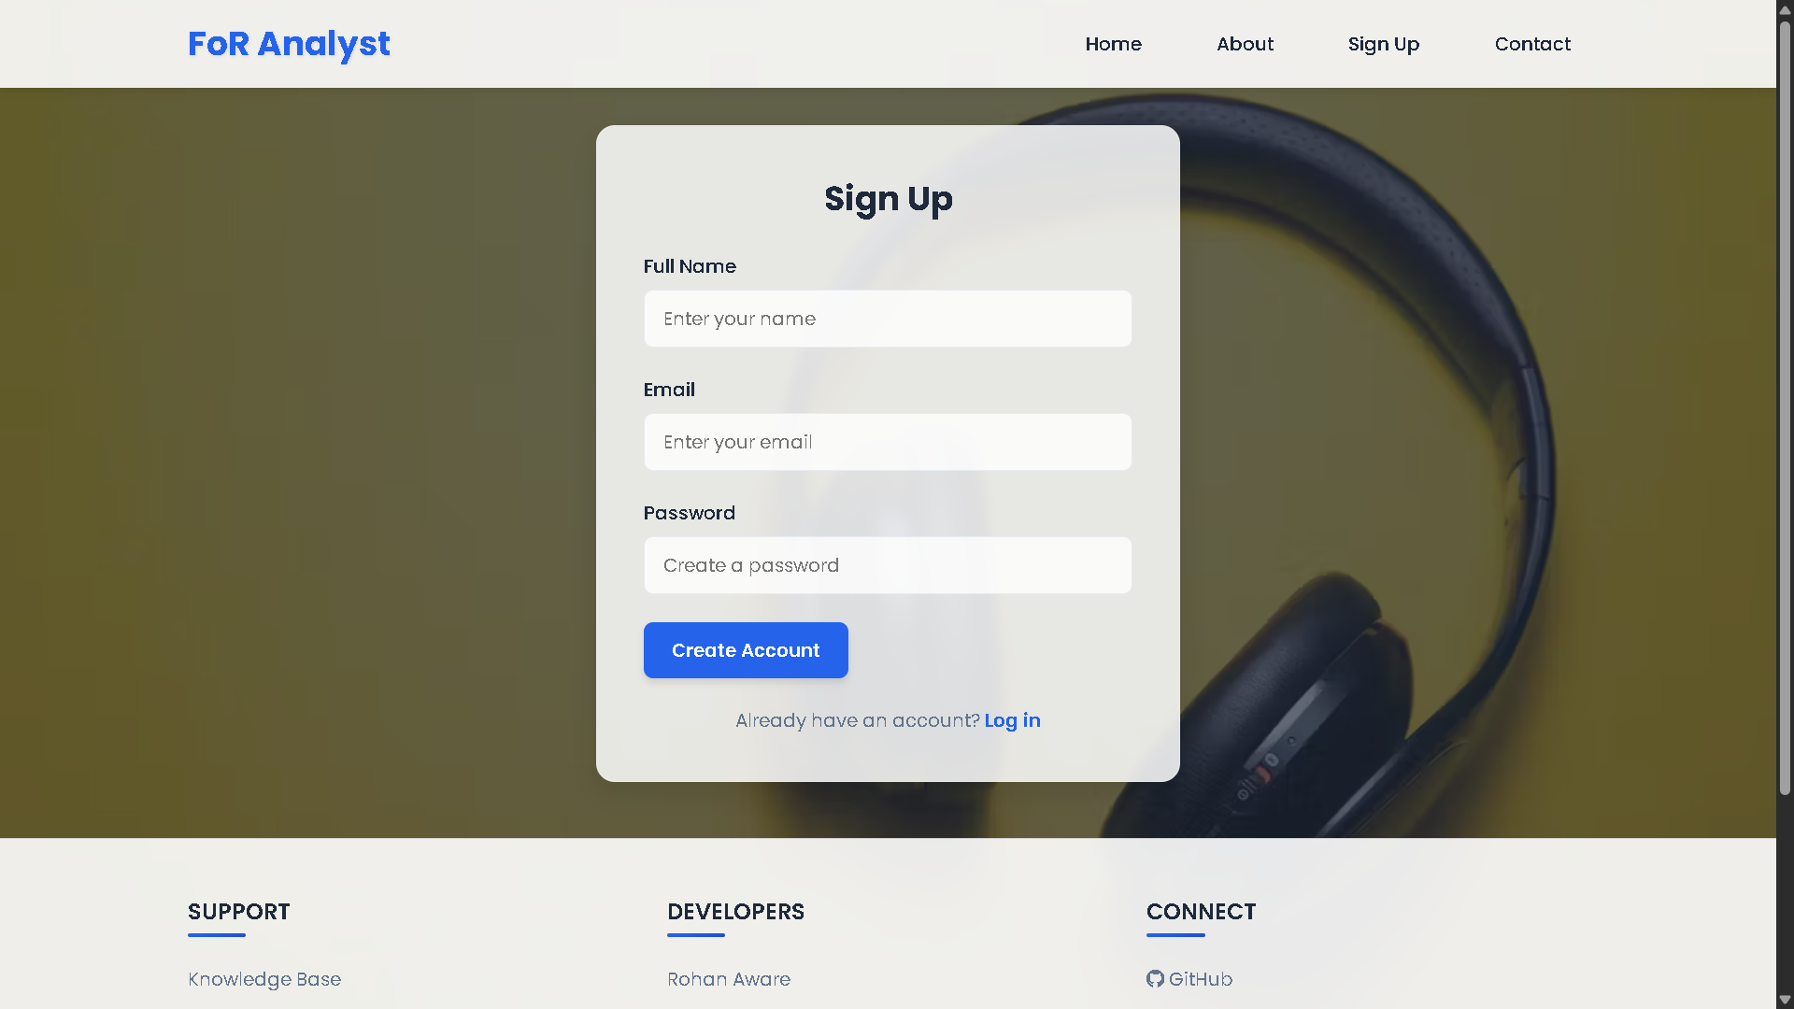

Slide 30
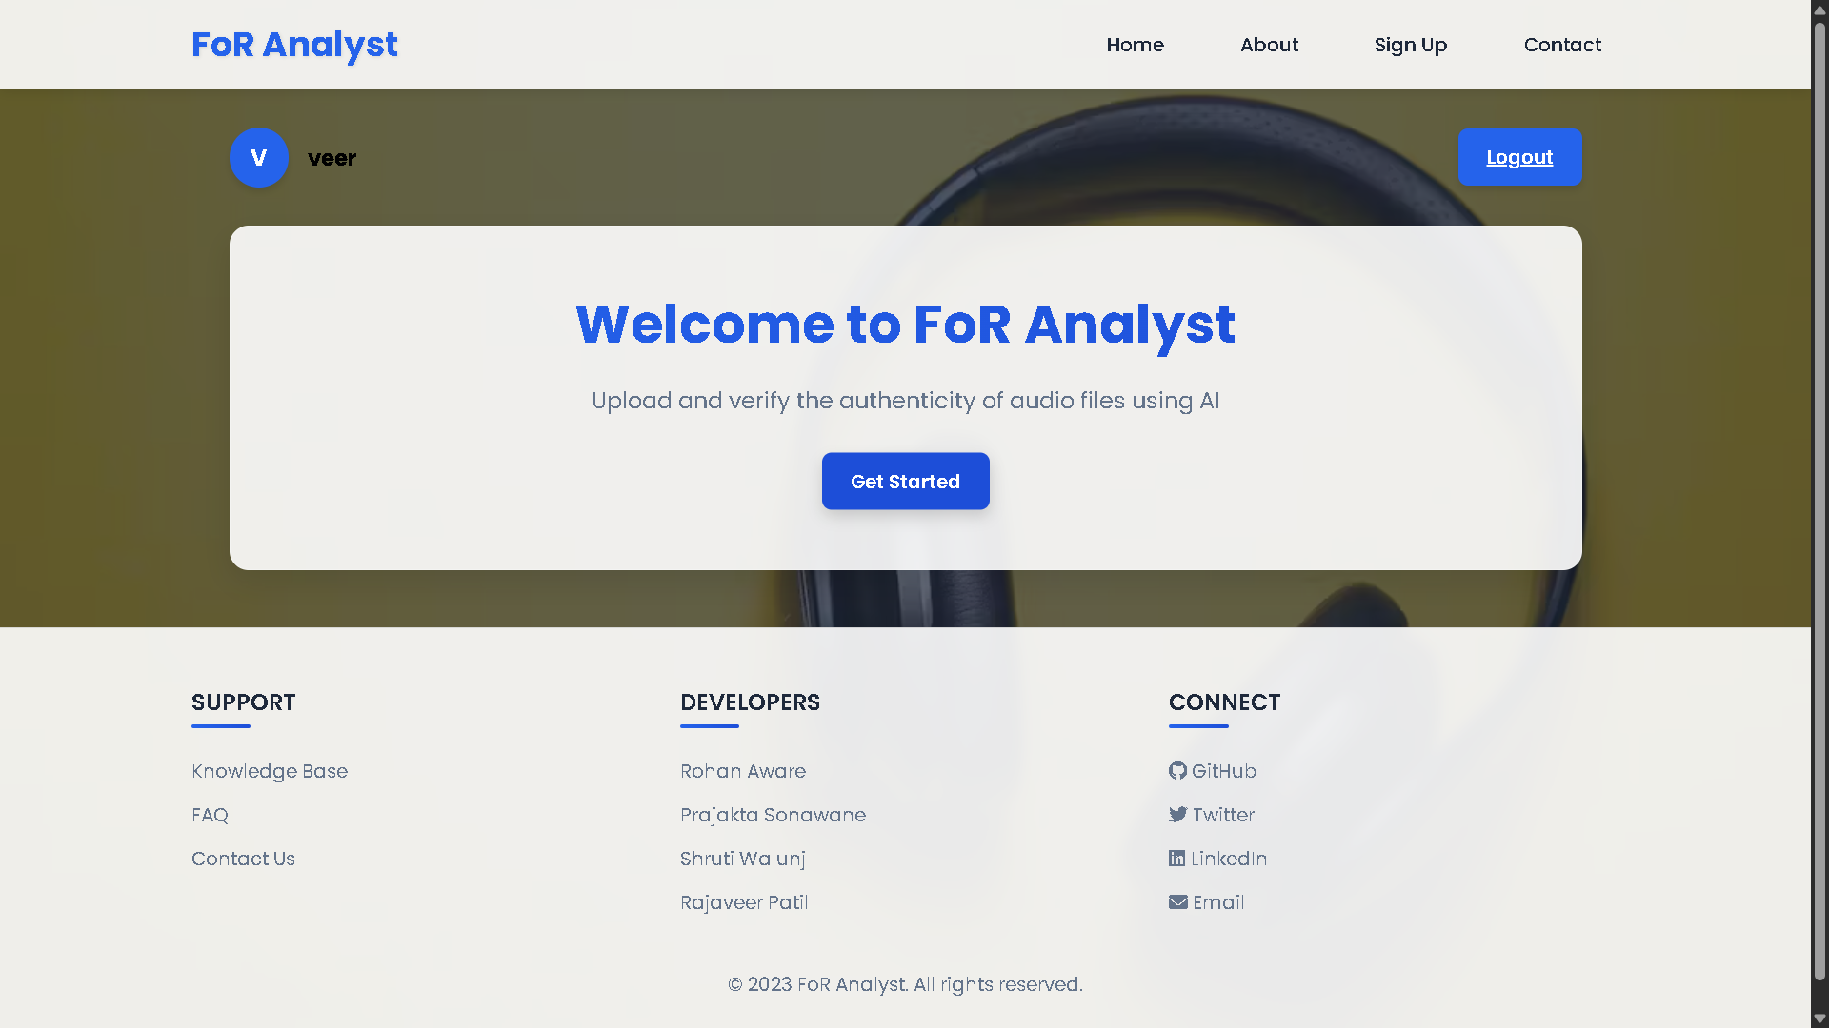

Slide 31
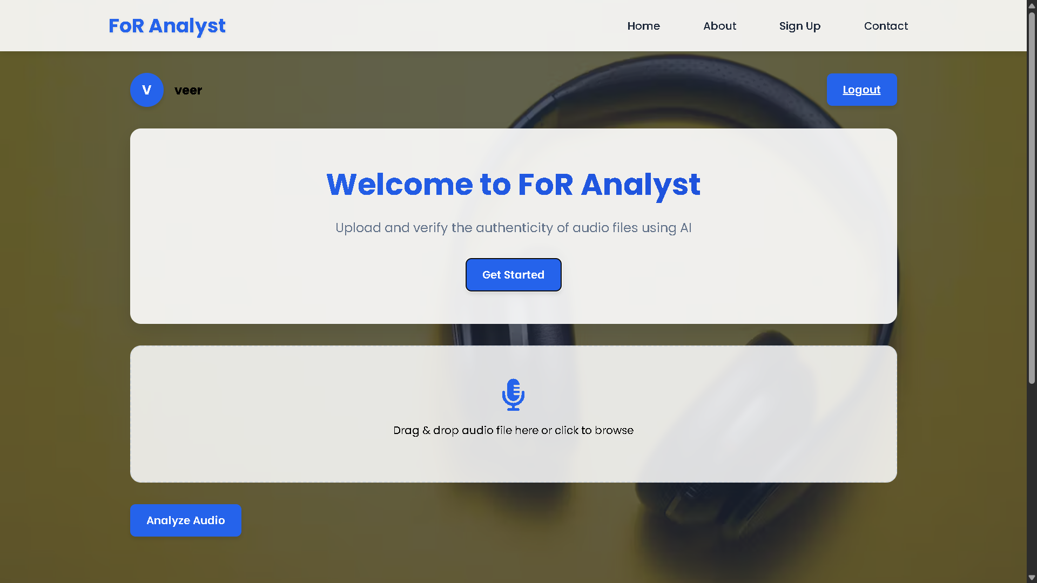

Slide 32
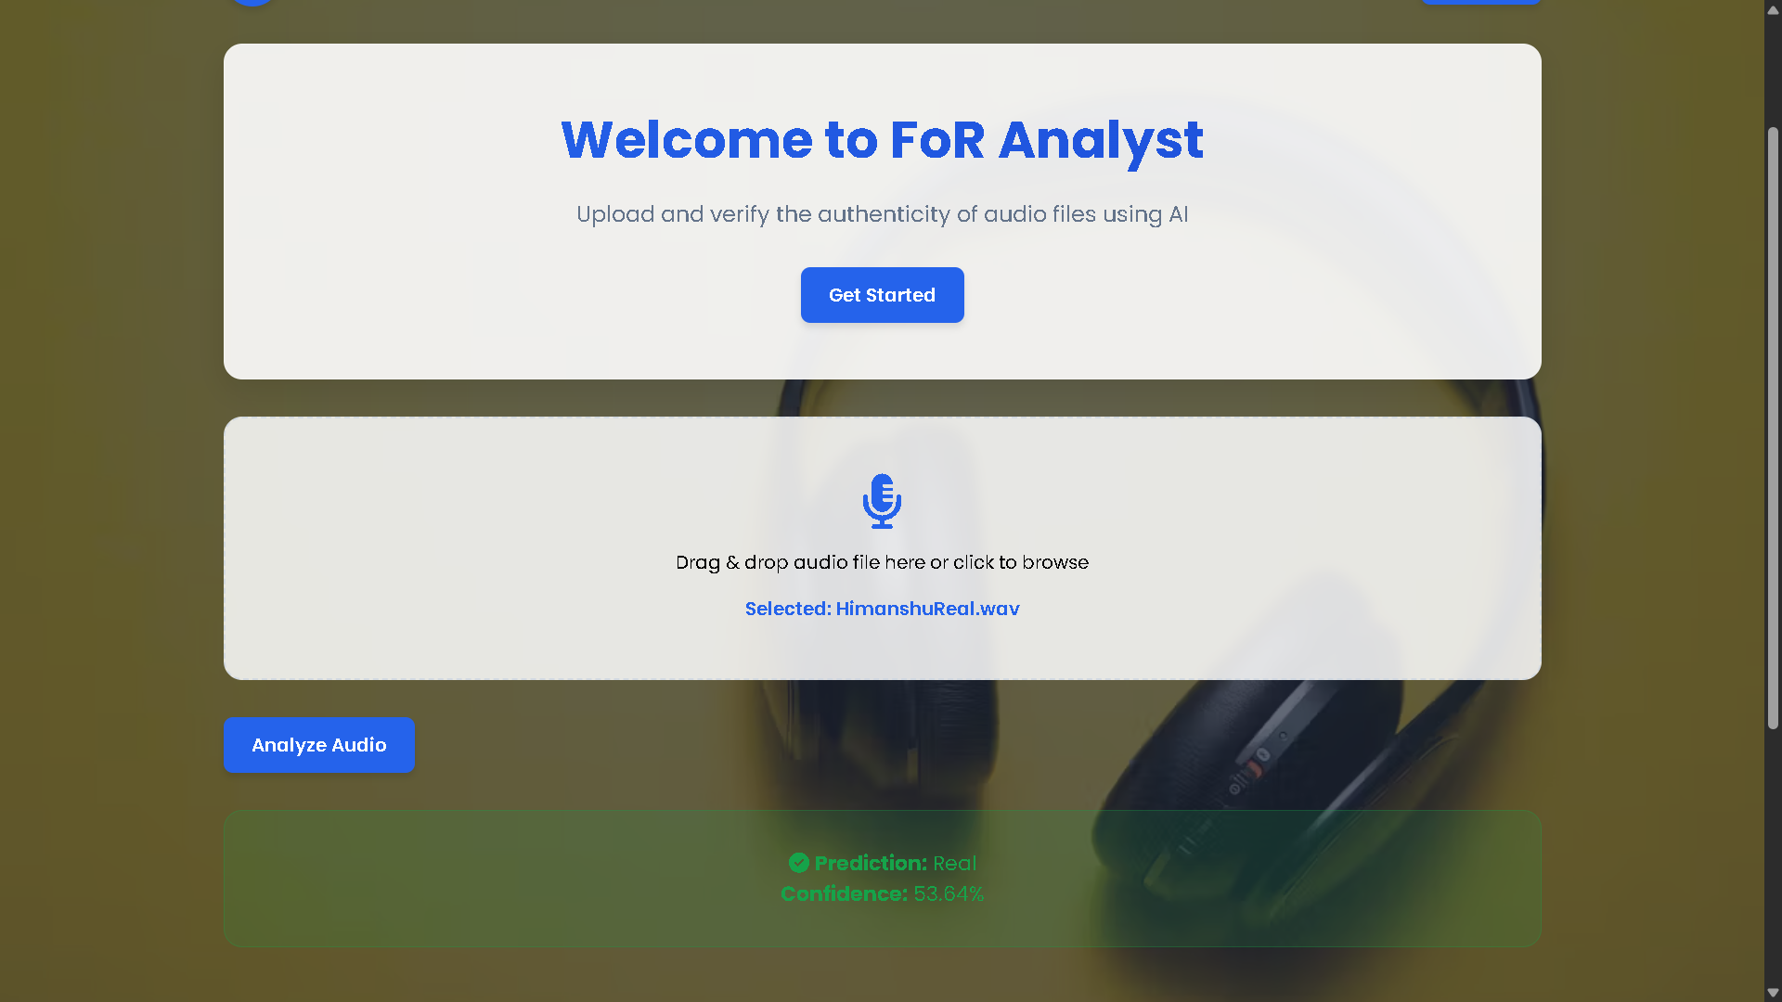

Slide 33
References
1
Mixture of Experts Fusion for Fake Audio Detection Using Frozen wav2vec 2.0
Zhiyong Wang, Ruibo Fu, Zhengqi Wen, Jianhua Tao, Xiaopeng Wang1, Yuankun Xie, Xin Qi, Shuchen Shi, Yi Lu, Yukun Liu, Chenxing Li, Xuefei Liu, Guanjun Li; 2024/9/18; arXiv preprint arXiv:2409.11909
2
Open Challenges in Synthetic Speech Detection
Cuccovillo, Christoforos Papastergiopoulos, Anastasios Vafeiadis, Artem Yaroshchuk, Patrick Aichroth, Konstantinos Votis, and Dimitrios Tzovaras; arXiv:2209.07180v3 [eess.AS] 26 Jan 2023
3
Temporal Variability and Multi-Viewed Self-Supervised Representations to Tackle the ASVspoof5 Deepfake Challenge
Zhiyong Wang, Xiaopeng Wang, Yuankun Xie, Ruibo Fu1, Zhengqi Wen5, Jianhua Tao, Yukun Liu, Guanjun Li, Xin Qi, Yi Lu, Xuefei Liu, Yongwei Li; 2024/9/18; arXiv preprint arXiv:2409.11909
4
Temporal Variability and Multi-Viewed Self-Supervised Representations to Tackle the ASVspoof5 Deepfake Challenge
Yuankun Xie, Xiaopeng Wang, Zhiyong Wang, Ruibo Fu, Zhengqi Wen, Haonan Cheng, Long Ye; arXiv:2408.06922v1 [cs.SD] 13 Aug 2024
5
Genuine-Focused Learning using Mask AutoEncoder for Generalized Fake Audio Detection
Xiaopeng Wang, Ruibo Fu, Zhengqi Wen, Zhiyong Wang, Yuankun Xie, Yukun Liu, Jianhua Tao, Xuefei Liu, Yongwei Li, Xin Qi, Yi Lu, Shuchen Shi; arXiv:2406.03247v2 [cs.SD] 9 Jun 2024

Slide 34
References
6
Generalized Fake Audio Detection via Deep Stable Learning
Zhiyong Wang, Ruibo Fu, Zhengqi Wen, Yuankun Xie, Yukun Liu, Xiaopeng Wang, XuefeiLiu, Yongwei Li, Jianhua Tao, Yi Lu, Xin Qi, Shuchen Shi; arXiv:2406.03237v1 [cs.SD] 5 Jun 2024
7
The Codecfake Dataset and Countermeasures for the Universally Detection of Deepfake Audio
Yuankun Xie, Yi Lu, Ruibo Fu, Zhengqi Wen, Zhiyong Wang, Jianhua Tao, Xin Qi, Xiaopeng Wang, Yukun Liu, Haonan Cheng, Long Ye; arXiv:2405.04880v2 [cs.SD] 15 May 2024
8
An Efficient Temporary Deepfake Location Approach Based Embeddings For Partially Spoofed Audio Detection
Yuankun Xie, Haonan Cheng, Yutian Wang, Long Ye; arXiv:2309.03036v2 [cs.SD] 21 Nov 2023
9
Towards End-to-End Synthetic Speech Detection
Guang Hua, Andrew Beng Jin Teoh, Haijian Zhang; arXiv:2106.06341v1 [eess.AS] 11 Jun 2021
10
Audio Deepfake Detection With Self-supervised Wavlm And Multi-fusion Attentive Classifier
Yinlin Guo, Haofan Huang, Xi Chen, He Zhao, Yuehai Wang; arXiv:2312.08089v2 [eess.AS] 10 Jan 2024

